Slide 1

Discharge Planner Analytics Case
Roy Subhadeep

Slide 2
Agenda
The Challenge
Discuss the challenge and analyze ways of tackling it with real data.
Discuss the assumptions and limitations on which the data analytics in based on
Data Analytics
Discuss the data sources and the models used
Recommendations
Analyze the results and discuss the recommendations
Q&A
Your favorite part

Slide 3

The Challenge
Helping Dorothy make more informed decisions while planning discharges
It all begins with an
Why does Dorothy need help?
How can I best help Dorothy?
What do I need to help Dorothy?
What do I have NOW to help Dorothy?
How do I propose to help Dorothy?

Slide 4
The Challenge
Helping Dorothy make more informed decisions while planning discharges
It all begins with an
Why does Dorothy need help?
To reduce readmission rate & avoid steep fine
Fact:
In 2011, approximately 25% of nursing home residents experienced hospitalizations. 21% of Medicare Fee-for-Service beneficiaries were readmitted within 30 days

Slide 5
The Challenge
Helping Dorothy make more informed decisions while planning discharges
It all begins with an
How can I best help Dorothy?
By creating a Predictive model which she can use in real time to generate recommendations on nursing facilities & home health agencies by inputting Patient’s data

Slide 6
The Challenge
Helping Dorothy make more informed decisions while planning discharges
It all begins with an
What do I need to help Dorothy?
Access to historic patient data of the hospital including patient’s medical history and family records
Access to the hospital re-admission data
Access to the geographic location of the hospital
Access to post acute care facilities’ data

Slide 7
The Challenge
Helping Dorothy make more informed decisions while planning discharges
It all begins with an
What do I have NOW to help Dorothy?
Hospital & Post Acute Care facilities data
How do I propose to help Dorothy?
By identifying important factors influencing re-admission rates

Slide 8
The Challenge
Helping Dorothy make more informed decisions while planning discharges
It all begins with an
Scope -
Scope of analysis is limited to hospitals and post acute care facilities in Philadelphia, PA.
All hospitals in Philadelphia were considered.
Assumptions -
Patient’s home locations assumed to be the hospital’s location.

Slide 9
Data Analytics
Data Extraction
Exploratory Data Analysis
Statistical Tests
Results

Slide 10
Data Extraction
Data
Key Measures for scoring
HOME HEALTH AGENCIES COMPARE
Star Rating
Type of ownership
Location
NURSING FACILITIES COMPARE
Star Rating
Type of ownership
Location
DATA SOURCE
Data.medicare.gov
HOSPITALS COMPARE
Excess Readmission Ratio
Measure Name
Location

Slide 11
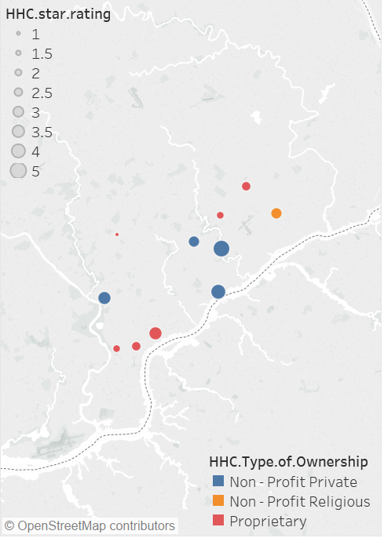
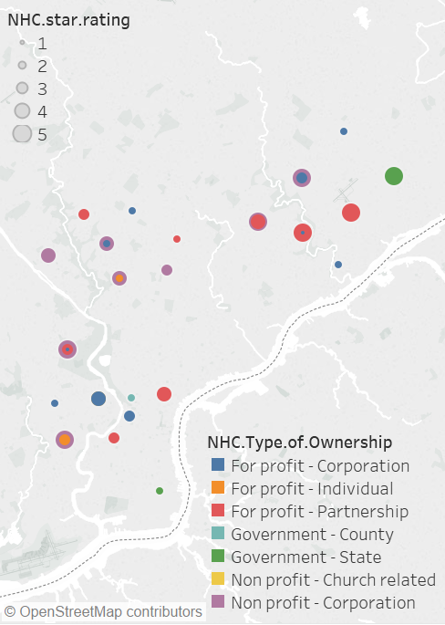
Concentration of Rated Facilities
Rated Home Health Agencies in Philadelphia
Rated Local Skilled Nursing Facilities in Philadelphia
Data Extraction
Exploratory Data Analysis
Statistical Tests
Results

Slide 12
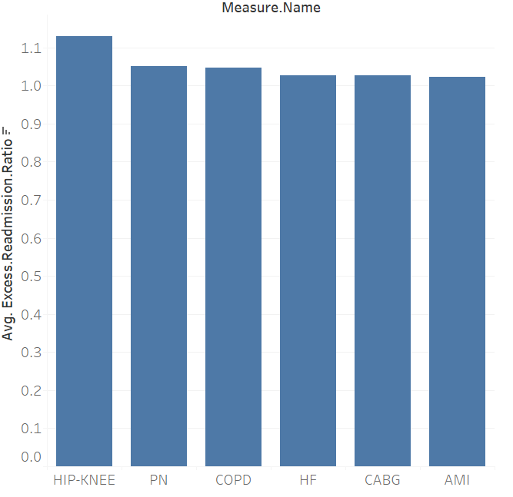
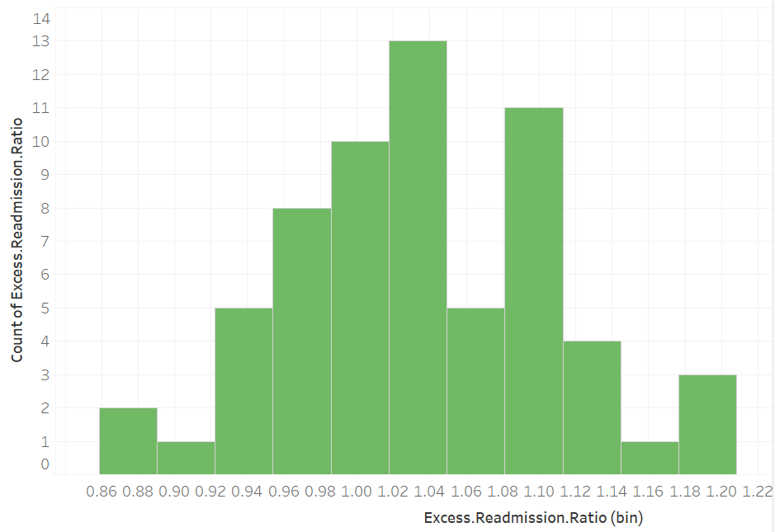
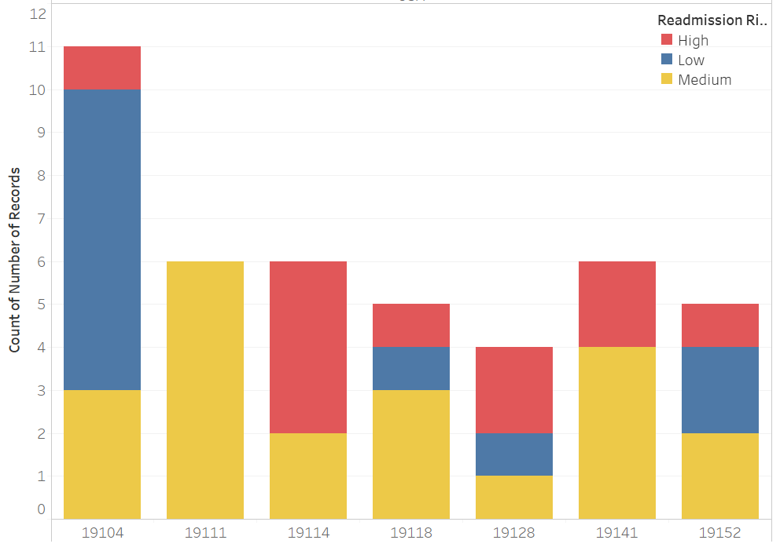
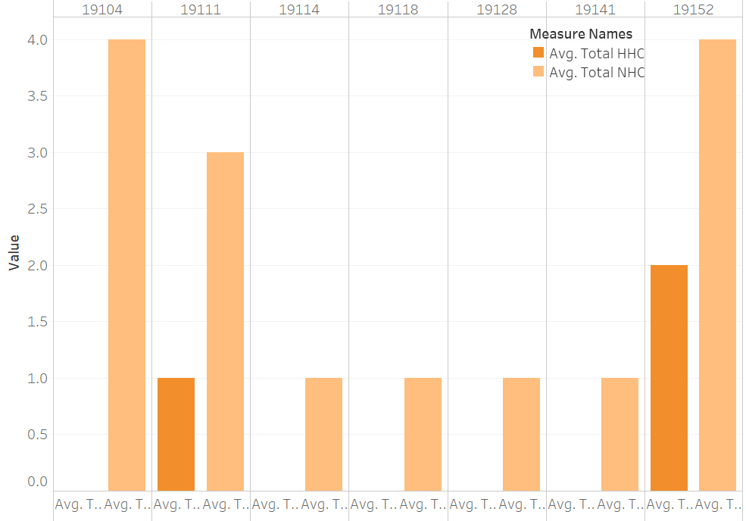
Data Distribution
Excess re-admission ration in hospitals is highest among HIP KNEE.
Min. 1st Qu. Median Mean 3rd Qu. Max.
0.8709 0.9949 1.0416 1.0474 1.0853 1.2889
Distribution of Excess readmission rates among hospitals.
Postal code associated risk factors.
Postal code distribution of Home Health & Nursing Facility.
Notes:
Count of high risk healthcare community

Slide 13
Model Plan
Merge Data
Home Health and Nursing facilities were merged to hospital data (primary).
Create Scoring Metrics
Score the model on:
Count of nearby Home Health for 1-5 ratings
Count of Nearby Nursing for 1-5 ratings
Count of Ownership Type & measure type
Preprocess & Fit Model
Identify multicollinearity & feature scaling.
Score model.
Statistical test validation
Validate model and run statistical tests.
Data Extraction
Exploratory Data Analysis
Statistical Tests
Results

Slide 14
Feature Importance
Output using AIC indicate it’s a dependable model.
Positive coefficients of high rated nursing facilities is questionable. However, ANOVA indicates there are no significant differences in means.
Can be attributed to inadequate amount of data.
Model scores using AIC

Slide 15
Facility Recommendations
Results indicate -
The number of highly rated facilities nearby is insignificant.
“For profit – Corporation” Nursing Home ownership type greatly reduce the hospital readmissions rates.
Joint replacement measure should be considered as a high risk category.
Facility?
For profit – Corporation” ownership type
> Average/best Rated
Distance
Metric
Data Extraction
Exploratory Data Analysis
Statistical Tests
Results

Slide 16
Recommendation Plan
Hospitals
Post – acute care
Reducing re-admissions
Post – acute care
Skilled Nursing Facility
Home Health Agencies
Readmission Risk
Readmission Risk
Readmission Risk
Readmission Risk
High
Medium/Low
(Distance Factor)
High
(Distance Factor)
Medium/Low
(Distance Factor)
STAR RATE 4
STAR RATE 3
STAR RATE 5
STAR RATE 3.5
CENTENNIAL HEALTHCARE
OAKWOOD HEALTH
DEER MEADOWS
VNA, BAYADA
STAR RATE 3
STAR RATE 4
STAR RATE 4
SPRINGS WATERMARK
VITAL SUPPORT
HOLY REDEEMER, TEMPLE HEALTH
‘For Profit – Corporation’ only
Non Profit Others, Proprietary

Slide 17
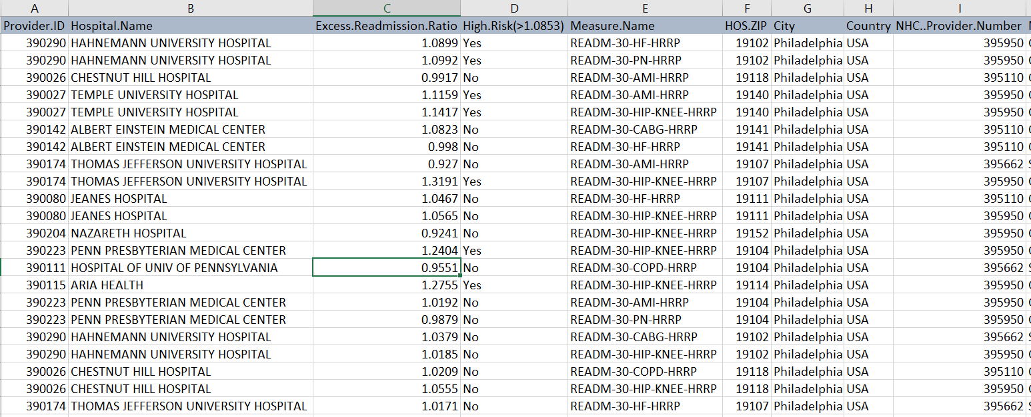
References
Recommendation Plan Metrics: (hyperlink embedded)
References:
www.cms.gov
www.data.medicare.gov
https://www.ncbi.nlm.nih.gov/pmc

Slide 18
Questions?

